Slide 1
Berlinsbi.com
Enterprise•Leadership•Success

Slide 2
Agenda
Who are we?
Why study at BSBI?
Academic partnership
What do our students say?
Our campus
Why study in Berlin?
Our programmes
Entry requirements
Online application
What’s next?
Course fees
Career services
Accommodation
Q&A
Contact

Slide 3
Why Study at BSBI?
1. Central location
Study in a well-equipped campus located in the heart of Berlin, Germany’s capital. Germany is the most popular option for international students looking to study in Europe*.
5. Free German Language lessons
This will help you increase your employment opportunities in Germany after graduation.
2. Excellent student support
Excellent academic tuition, guaranteed small-sized classes, industry experts and guest speaker presentations.
6. Dedicated career service
Our dedicated career experts can work with you to develop and action plan: they will help you perfect your CV and they will advise you on your interview techniques and presentation skills.
3. Flexible Timetable
BSBI's ground-breaking model enables you to complete your course by simply attending tutorials two days a week, leaving you three entire days to progress towards your career.
7. Online resources
BSBI has integrated the Virtual Learning Environment (VLE) into the heart of their teaching and e-learning programmes.
4. Free Executive Education course
BSBI and London School of Business and Finance (Executive Education) have partnered to offer BSBI students the chance to attend a FREE five-day executive course, while pursuing their degree.
8. Post study German visa
After graduating, students will be able to extend their residence permit for up to 18 months to take advantage of career opportunities in Germany. You will need to have a good level of German.

Slide 4
Academic partnership
Established in 2005; it delivers bachelor’s degrees, specialisation degrees, research doctorates and university master’s degrees acknowledged throughout the world.
UNINETTUNO is a distance-teaching university based on close cooperation with traditional universities from Europe, the Arab World, the United States and Asia.

Slide 5
Academic partnership
BSBI is proud to offer two of Concordia-Chicago’s most bespoke degree programmes, which are taught at our central Berlin campus.
MA in Innovation and Entrepreneurship (MAIE)
Master’s in Business Administration (MBA)
This unique opportunity will allow BSBI students to earn a degree from a U.S institution without having to travel and study in the U.S.
The programmes offered by Concordia-Chicago are fully accredited by the Higher Learning Commission (HLC). In addition, the University’s College of Business is a member of the Accreditation Council for Business Schools and Programs (ACBSP).

Slide 6
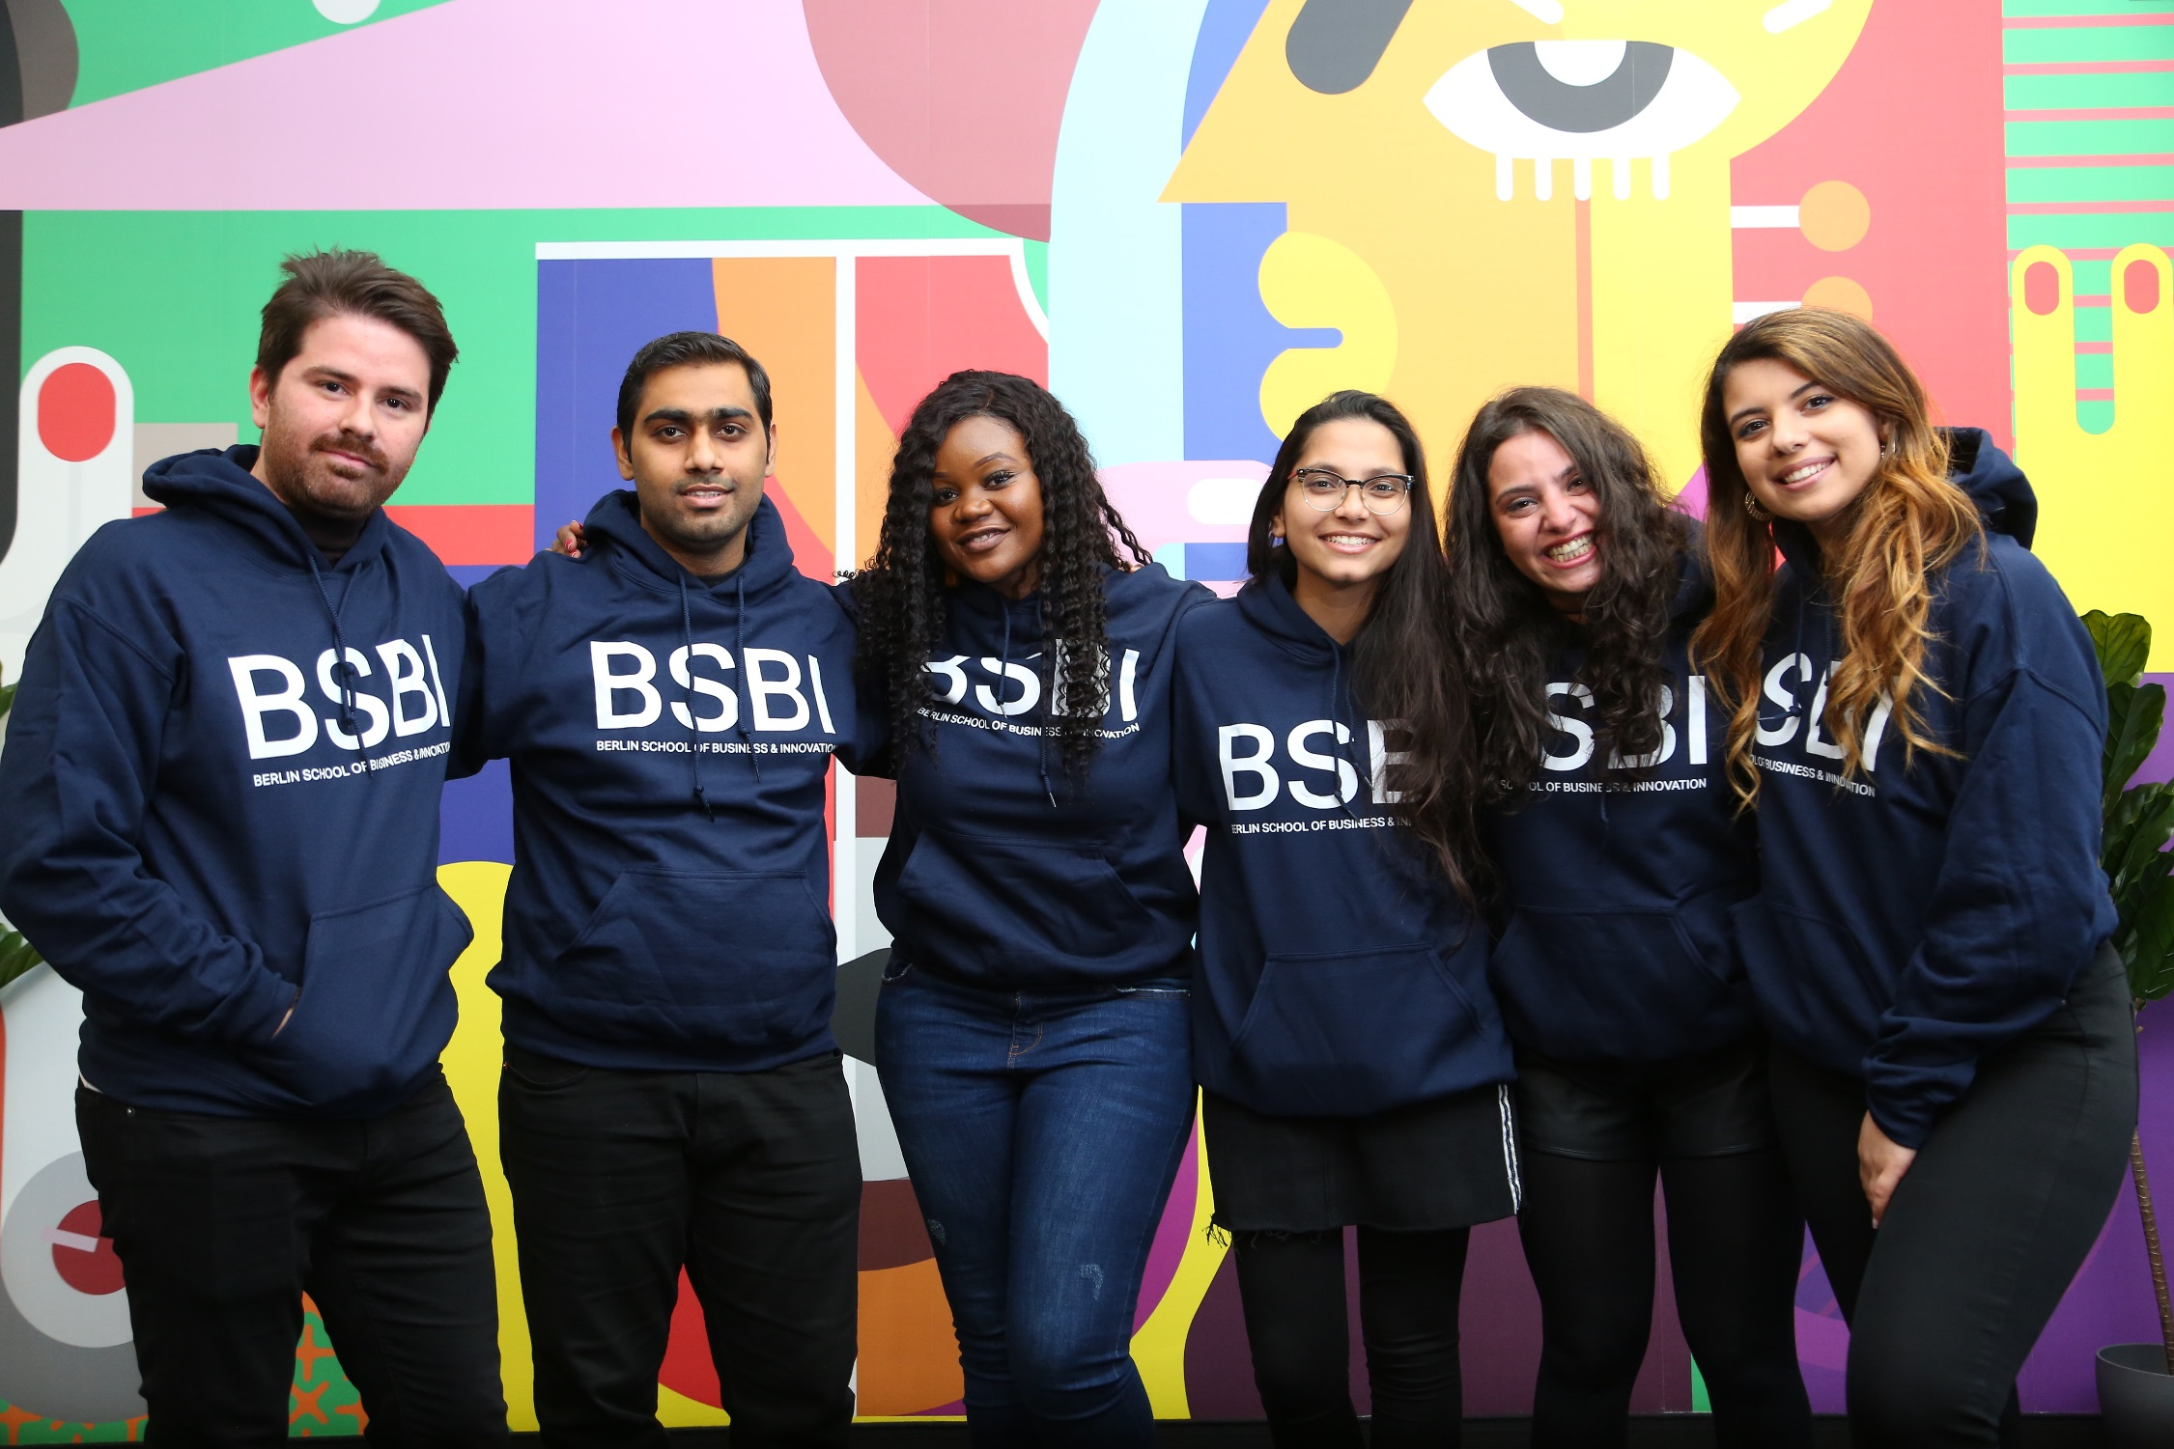
What our students say

Slide 7
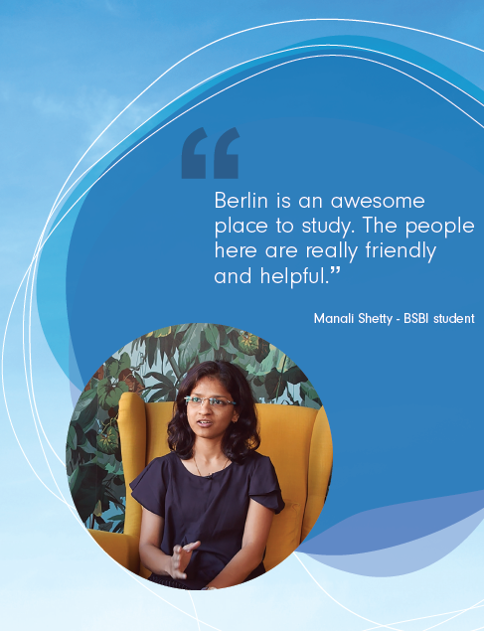

Slide 8
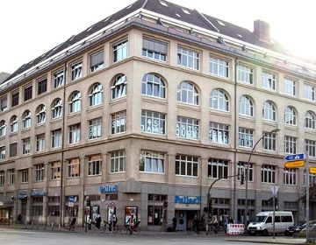
Our campus

Slide 9
Our campus

Slide 10
Why study in Berlin?

Slide 11
Reasons to study in Berlin
1
Berlin’s strong economy
2
Start-up capital of Europe
3
Students can work part-time
4
Top 10 rated student city
5
Affordable
living cost

Slide 12
Our programmes
Undergraduates
BA in Economics and Business Administration with Foundation Diploma
BA in Economics and Business Administration
Postgraduates
MSc in International Health Management
MA in Innovation and Entrepreneurship
MA in International Tourism, Hospitality and Event Management
MA in Strategic Marketing
MA in Finance and Investments
Global MBA
MBA in Maritime and Shipping Management
MBA
Doctorate
DBA (Doctorate in Business Administration)

Slide 13
Courses fees

Slide 14
Programme | Price * | Intake
BA in Economics and Business Administration with Foundation Diploma | International: Foundation Diploma €6,500 plus annual fee for BA €9,500 EU: Foundation Diploma €6,000 plus annual fee for BA €6,500 | Feb | May | Oct
BA in Economics and Business Administration | International: €9,500 /year EU: €6,500/year | Feb | May | Oct
MBA | International: €9,000 /year EU: €9,000/year | Mar | May | Oct
Global MBA | International: €13,250 EU: €7,000 | Feb | May | Oct
MBA in Maritime and Shipping Management | International: €13,250 EU: €7,000 | Feb | Oct
MA in Innovation and Entrepreneurship | International: €7,500 /year EU: €7,500/year | Mar | May | Oct
MA in International Tourism, Hospitality and Event Management | International: €11,800 EU: €6,300 | Feb | May | Oct
MA in Finance and Investments | International: €11,800 EU: €6,300 | Feb | Oct
MA in Strategic Marketing | International: €11,000 EU: €6,000 | Feb | Oct
MSc in International Health Management | International: €11,800 EU: €6,300 | Feb | May | Oct
DBA (Doctorate in Business Administration) | International: €15,000/year EU: €15,000/year | Feb | Oct

Slide 15
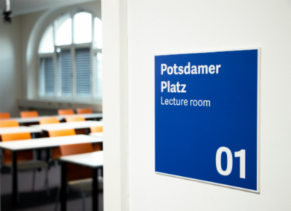
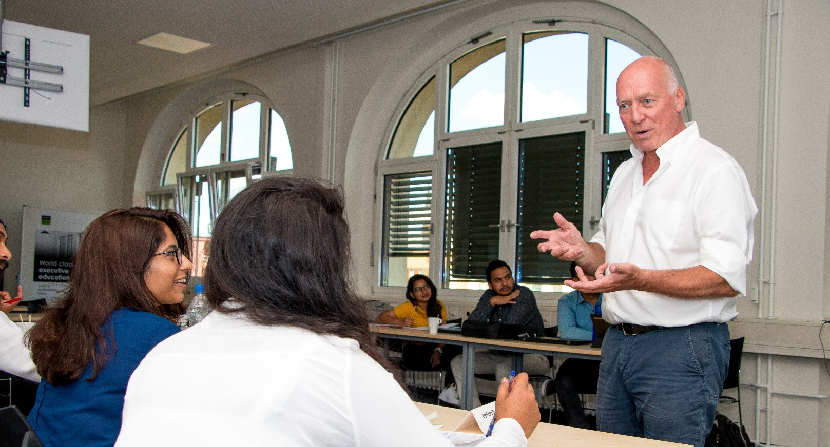
Entry Requirements

Slide 16
Uninettuno Entry Requirements
BA Admissions Criteria
BA with Foundation Diploma Admissions Criteria
Minimum Age | 18 years old
Academic Qualifications | High School, titles awarded upon completion of at least 12 years of schooling.
English Language Requirementts | IELTS 6.0 (no less than 5.5 in any component), PTE 50 +score, or equivalent.
Minimum Age | 17 years old
Academic Qualifications | NARIC equivalent to GCSE (titles awarded upon completion of at least 11 years of schooling)
English Language Requirements | IELTS 5.0 (no less than 4.5 in any component), PTE 42 +score, or equivalent.
Application Supporting Documents:
Application Supporting Documents:
Completed Application Form
School Leaving Certificates
Letter of motivation (1 page)
CV/résumé
Recent passport size photograph
Proof of English language proficiency (e.g. IELTS, PTE, TOEFL)
Copy of the Passport
Application form
Scanned colour copy of passport/ID for EU applicants
Proof of English proficiency
High school certificate and transcripts
Personal statement
CV
Parental Consent form for applicants age of 17

Slide 17
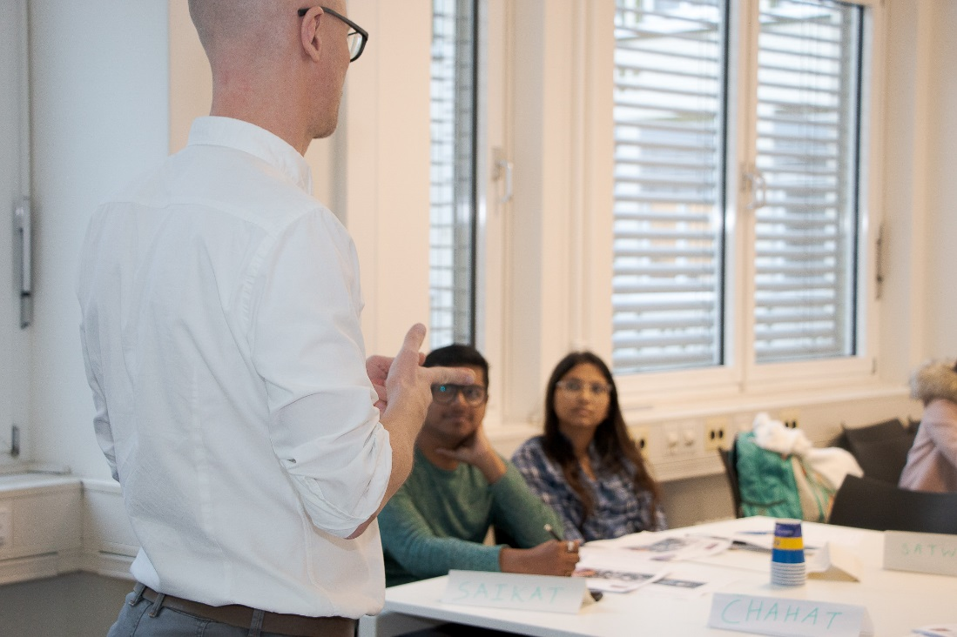
Uninettuno Entry Requirements
Postgraduate Admissions Criteria
Minimum Age | 21 years old.
Academic Qualifications | Undergraduate degree from a recognised university.
English Language Requirements | IELTS 6.0 (no less than 5.5 in any component), PTE 50 +score, or equivalent.
Application Supporting Documents:
Completed Application Form
School Leaving Certificates
Degree Certificate/s & Diploma/s
Degree Transcripts & Grades for each semester
Letter of motivation (1 page)
CV/résumé
One reference letter
Recent passport size photograph
Proof of English language proficiency (e.g. IELTS, PTE , TOEFL)
10. Copy of the Passport

Slide 18
CUC Entry Requirements
Postgraduate Admissions Criteria
Minimum Age | 21 years old.
Academic Qualifications | Bachelor’s degree from a U.S. equivalent, regionally accredited institution. GPA earned 2.25 or above
English Language Requirements | IELTS – minimum score of 6.0, or; TOFEL – minimum score of 72 (internet-based), or; PASSWORD – minimum score of 6.0.
Application Supporting Documents:
Completed application;
Objective statement;
Copy of official transcript;
Copy of passport;
Two letters of recommendation;
Declaration of finances/bank statement;

Slide 19
What’s next?
Receive your study contract
Pay a required deposit
Contact German Embassy
Admissions team will send your confirmation letter for your programme and a request for a deposit.
Secure your spot on the programme.
Find out about the visa process in your country.
Provided correct documents
Attend an interview
Board on a plane to Germany!
This will depend on your home country.
Once you have the initial 3-6 months visa and have booked your flight, you can start your accommodation process.
As soon as you have entered Germany, register at the local registration office and ask them from for the forms needed to apply for a residence permit for studying in Germany.

Slide 20
Career services
1. Career guidance
We offer personalised support to help you make decisions about your future and plan for how you’re going to get to where you want to be.
2. Employability service
By combining theory with practice, BSBI bridges the gap between education and the rapidly changing needs of today’s global market place.
3. Coaching
When you begin the job application process, the careers centre is on-hand to help you tailor your application for any position.
4. Networking events
BSBI organises networking events to link students with businesses. Our networking opportunities are unique as we give students the chance to work on certain topics and develop ideas with company representatives.
5. Coaching pool
BSBI supports life-long learning and developing our students into tomorrow’s success stories. Our coaching pool enables you to work with experts from a range of sectors and enhance skills.
6. Company presentations Company representatives from leading German and international firms are invited to BSBI to teach students about their work. The visits give students the chance to learn about organisational value and any open recruitment positions.

Slide 21
Accommodation in Berlin
Our partners offer short- and long-term rental contracts

Slide 23
Contact
Potsdamer Straße 180-182
10783 Berlin, Germany
Office Hours: 9:00 - 18:00
Phone: +49 305 85840959
Email: info@berlinsbi.com

Slide 24
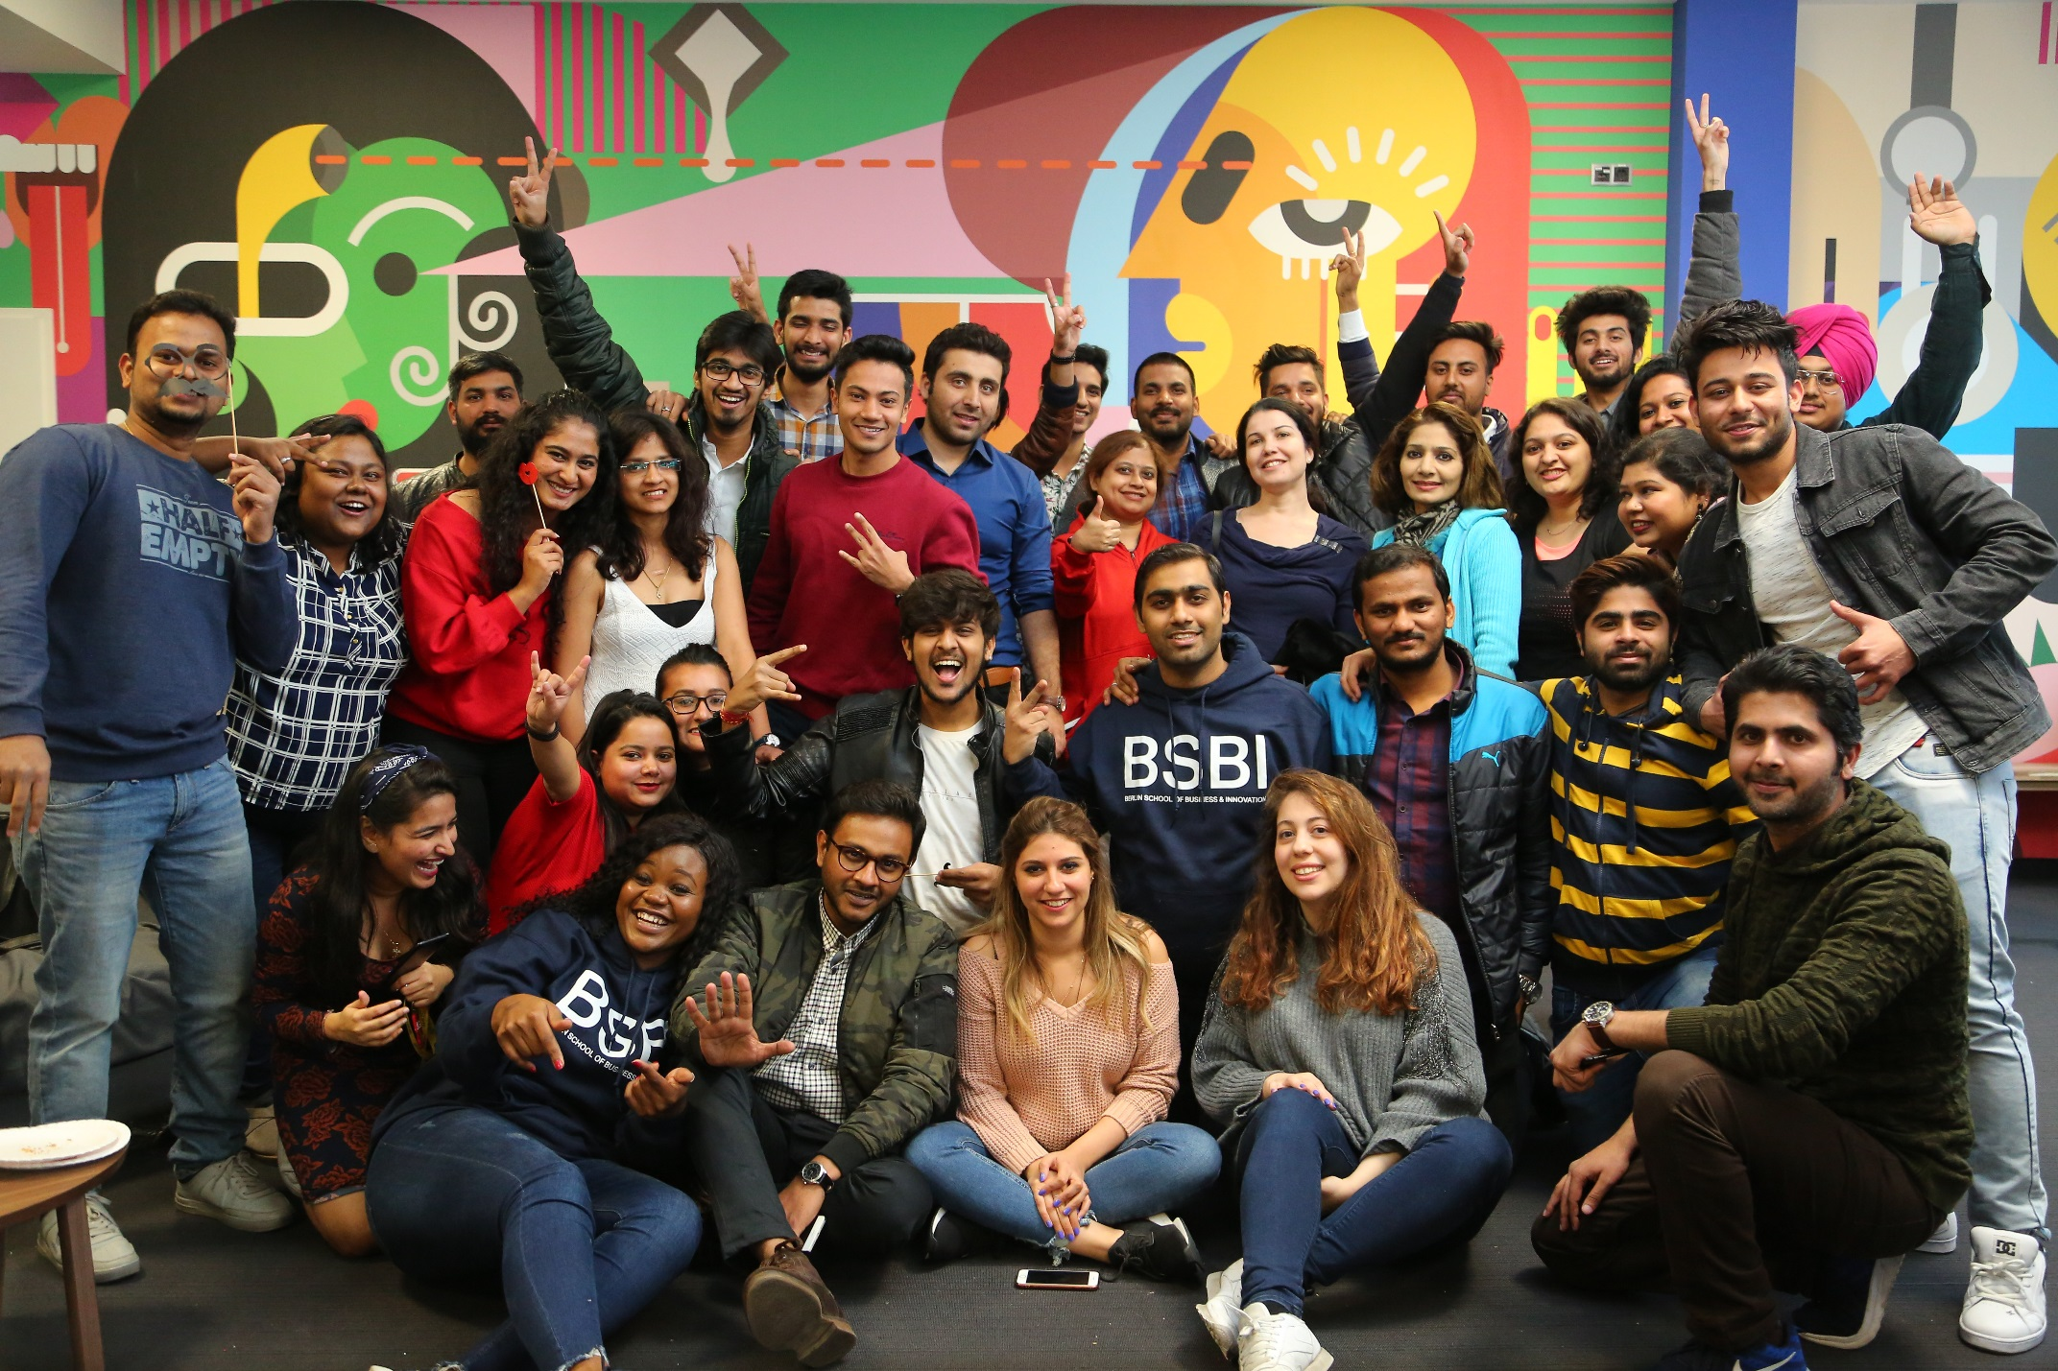
Thank you!

